Slide 1
Computer Organization
Computer Organization - It tells us how exactly all the hardware units in the system are arranged and
interconnected. It focuses on:
Physical components
Internal connections
Data flow inside the system
In simple words:
Computer Organization = Internal hardware structure
Computer Architecture – It helps us to understand the functionalities of a system. It focuses on:
What operations the computer can perform
How a programmer uses the computer
What instructions the CPU understands
In simple words:
Computer Architecture = Capabilities of the computer

Slide 2
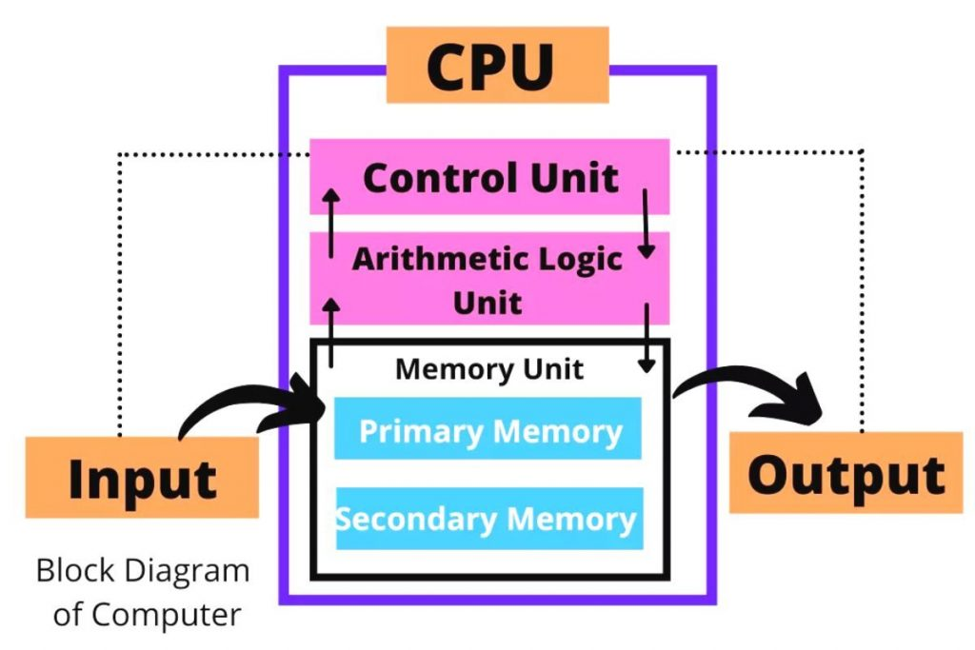
Basic Organization of a Computer
The Input Unit is used to enter data and instructions into the computer.
2. The Control Unit:
Controls the entire operation of the computer
Decides what to do, when to do, and how to do
3. The ALU performs:
Arithmetic operations: +, −, ×, ÷
Logical operations: AND, OR, NOT, comparisons
4. Primary Memory :RAM, Cache
Characteristics: Fast access, Temporary storage, Data is lost when power is off
5. Secondary Memory: Hard Disk, SSD, Pen Drive
6. The Output Unit:
Displays the result of processing
Converts machine-readable output into human-readable form

Slide 3
User gives input
Input goes to memory
CPU fetches data from memory
ALU processes the data
Result is stored back in memory
Output unit displays the result
This cycle is called the Fetch–Decode–Execute cycle.
Input Unit
Output Unit
Central Processing Unit (CPU)
Control Unit (CU)
Arithmetic And Logic Unit (ALU)
Memory Unit - (i)Primary memory (ii)Secondary memory

Slide 4
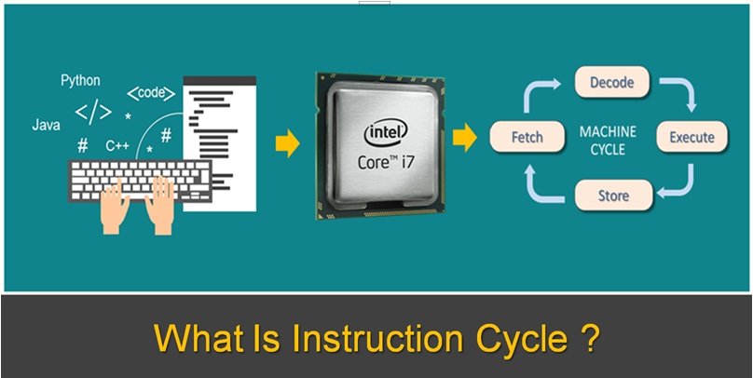
Example
Fetch → Read question
Decode → Understand question
Execute → Solve question
Store → Write answer
Instruction Cycle is the sequence of steps performed by the CPU to fetch, decode, execute, and store the result of an instruction.

Slide 5
Step 1: FETCH
What happens here?
The CPU fetches the instruction from memory
The instruction is stored in the Instruction Register (IR)
The address of the instruction is given by the Program Counter (PC).
Step 3: EXECUTE
What happens here?
The actual operation is performed
Done by:
ALU (for arithmetic & logic)
Or memory / I/O unit (depending on instruction)
Step 2: DECODE
What happens here?
The Control Unit (CU) decodes the instruction
It understands:
What operation to perform?
Which data is required?
Where the data is located?
Step 4: STORE (Write Back)
What happens here?
The result of execution is:
Stored in memory, or
Stored in a register
Output may be displayed later.

Slide 6
Overview
Instruction Codes
Computer Registers
Computer Instructions
Common Bus System
Timing and Control
Instruction Cycle
Memory Reference Instructions
Input-Output and Interrupt
Complete Computer Description
CSE 211, Computer Organization and Architecture

Slide 7
Introduction
Every different processor type has its own design (different registers, buses, microoperations, machine instructions, etc)
For example:
Intel processor ≠ ARM processor
Desktop CPU ≠ Mobile CPU
Modern processor is a very complex device
Many registers
Multiple arithmetic units, for both integer and floating point calculations
The ability to pipeline several consecutive instructions to speed execution
Run multiple programs at the same time
Execute millions of instructions per second
Support graphics, AI, gaming, networking
Modern processors are complex and powerful, but to understand their working, we first study a simplified processor model that clearly explains registers, instructions, and data flow.

Slide 8
Basic Computer
The Basic Computer has two components, a processor and memory
The memory has 4096 words in it
4096 = 2¹², so it takes 12 bits to select a word in memory
Each word is 16 bits (2 byte) long, so the memory organization is 4096 × 16.
1. Memory is divided into locations called words.
Each word has a unique address
Total number of words = 4096
So, memory addresses range from:
0 to 4095
CPU
RAM
0
4095
2. Each memory location stores 16 bits of data or instruction.
One memory word = 16 bits
This means:
Instructions in this computer are 16-bit instructions
Data is also stored in 16-bit format
15
0

Slide 9
Instruction
Program
A sequence of (machine) instructions
A collection of instructions arranged in a specific order to perform a particular task
The computer does not understand high-level languages directly.
(Machine) Instruction
A group of bits that tell the computer to perform a specific operation (a sequence of micro-operation)
A machine instruction is written in binary (0s and 1s), Is understood directly by the CPU. Each instruction triggers a series of micro-operations inside the CPU
The instructions of a program, along with any needed data are stored in memory
CSE 211, Computer Organization and Architecture

Slide 10
Instruction
The CPU reads the next instruction from memory
The fetched instruction is stored in a special register called the Instruction Register (IR)
IR holds only one instruction at a time
This instruction remains in IR until it is fully executed
Control circuitry in control unit then translates the instruction into the sequence of micro-operations
It is very necessary to implement it.
Without IR:
Instruction would not remain stable
Control Unit cannot decode properly
Execution becomes unreliable
IR acts as a bridge between memory and execution.
CSE 211, Computer Organization and Architecture

Slide 11
Instruction Format
A computer instruction is often divided into two parts
An opcode (Operation Code) that specifies the operation for that instruction
An address that specifies the registers and/or locations in memory to use for that operation
In the Basic Computer, since the memory contains 4096 (= 2¹²) words,
we needs 12 bit to specify which memory address this instruction will use
Instruction Format
15
14
12
11
0
I
Opcode
Address
Address field tells the CPU where the data is (A memory location or A register)
Addressing
mode
CSE 211, Computer Organization and Architecture

Slide 12
Instruction Format
How does the CPU know whether the address refers to actual data or to another address?
This is decided by something called the addressing mode.
In the Basic Computer,
15 bit of the instruction specifies the addressing mode
(0: direct addressing, 1: indirect addressing)
Since the memory words, and hence the instructions, are 16 bits long, that leaves 3 bits for the instruction’s opcode
Instruction Format
15
14
12
11
0
I
Opcode
Address
Addressing
mode
CSE 211, Computer Organization and Architecture

Slide 13
Addressing Mode
The address field of an instruction can represent either
Direct address: the address in memory of the data to use (the address of the operand), or
Indirect address: the address in memory of the address in memory of the data to use (2 memory access)
Effective Address (EA)
The address, that can be directly used without modification to access an operand for a computation-type instruction, or as the target address for a branch-type instruction
Direct addressing
Indirect addressing
22
0
ADD
457 (MA)
35
1
ADD
300 (MA)
300
1350 (MA)
457
Operand
1350
Operand
+
+
AC
AC
CSE 211, Computer Organization and Architecture

Slide 14
Processor (CPU) Registers
A processor has many registers to hold instructions, addresses, data, intermediate results etc
The processor has a register, the Program Counter (PC) that holds the memory address of the next instruction to get. PC always tells the CPU where the next instruction is located in memory.
Since the memory in the Basic Computer only has 4096 locations, the PC only needs 12 bits
CSE 211, Computer Organization and Architecture

Slide 15
Processor Register
In a direct or indirect addressing, the processor needs to keep track of what locations in memory it is addressing:
The Address Register (AR) is used for this
The AR is a 12 bit register in the Basic Computer
When an operand is found, using either direct or indirect addressing, it is placed in the Data Register (DR).
The processor then uses this value as data for its operation
The Basic Computer has a single general purpose register – the Accumulator (AC)
CSE 211, Computer Organization and Architecture

Slide 16
Processor Register
The significance of a general purpose register is that it can be referred to in instructions
LOAD AC, 200
STORE AC, 300
Meaning:
Load AC with contents of Memory[200]
Store contents of AC into Memory[300]
Since AC is mentioned in instructions, it is a general-purpose register
Often a processor will need a scratch register to store intermediate results or other temporary data; “TR helps the CPU, but the programmer never directly uses it.”
in the Basic Computer this is the Temporary Register (TR)
CSE 211, Computer Organization and Architecture

Slide 17
Processor Register
The Basic Computer uses a very simple model of input/output (I/O) operations
Input devices are considered to send 8 bits of character data to the processor
The processor can send 8 bits of character data to output devices
The Input Register (INPR) holds an 8 bit character gotten from an input device
The Output Register (OUTR) holds an 8 bit character to be send to an output device
CSE 211, Computer Organization and Architecture

Slide 18
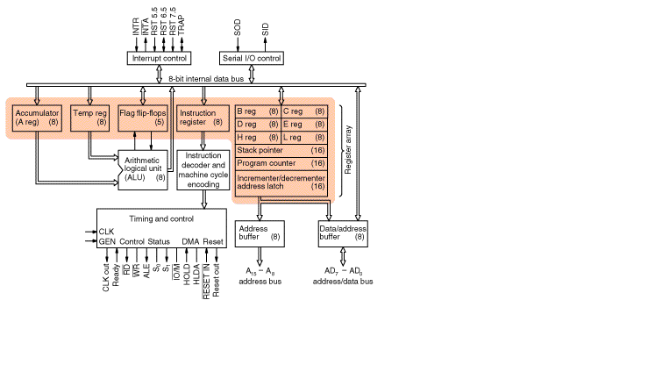
“Flags tell us the nature of the result after an ALU operation.”
Example:
If result = 0 → Z flag = 1
If carry generated → CY = 1

Slide 19
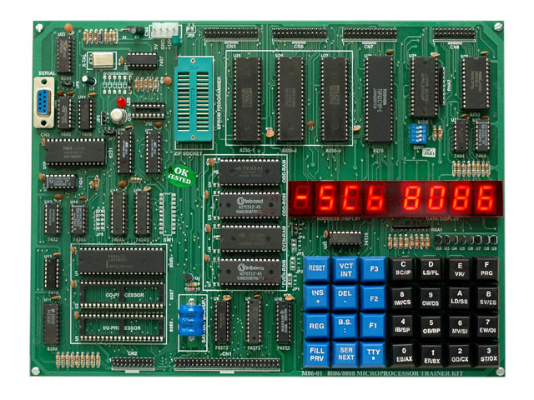
8085 microprocessor trainer kit

Slide 20
Processor Register
Registers in the Basic Computer
11
0
PC
Memory
11
0
4096 x 16
AR
15
0
IR
CPU
15
0
15
0
TR
DR
7
0
7
0
15
0
OUTR
INPR
AC
List of BC Registers
DR 16 Data Register Holds memory operand
AR 12 Address Register Holds address for memory
AC 16 Accumulator Processor register
IR 16 Instruction Register Holds instruction code
PC 12 Program Counter Holds address of instruction
TR 16 Temporary Register Holds temporary data
INPR 8 Input Register Holds input character
OUTR 8 Output Register Holds output character
CSE 211, Computer Organization and Architecture

Slide 21
Common Bus System
The registers in the Basic Computer are connected using a bus
This gives a savings in circuitry over complete connections between registers
Bus = a set of shared wires
Only one register places data on the bus at a time
Another register reads data from the bus
CSE 211, Computer Organization and Architecture

Slide 22
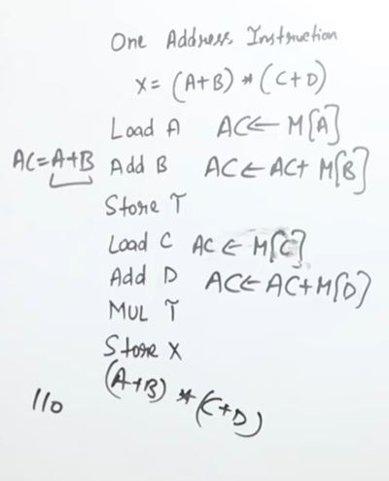
Common Bus System
S1
Bus
8*1 mux used for 16 bit common bus
E is like a flip flop which used to store the extra bit
INPR and OUTR are bit different
GIVE 010 SELECT LINES AND PC VALUE WILL COME ON THE BUS
Select load value of AR as 1and now address goes in the AR
Read data from memory by selecting 111 and load data on common bus
Load data in the DR
Give data to ALU then to AC, select 100 and load data on the common bus
Give to OUTR as load =1
All control statements are connected to common clock, by activating clock value we can load data.
S0
Memory unit
7
4096 x 16
Address
Write
Read
AR
1
LD INR CLR
PC
2
LD INR CLR
DR
3
LD INR CLR
E
ALU
AC
4
LD INR CLR
INPR
IR
5
LD
TR
6
LD INR CLR
OUTR
Clock
LD
CSE 211, Computer Organization and Architecture

Slide 23
Common Bus System
Three control lines, S₂, S₁, and S₀ control which register the bus selects as its input
Memory read transfers data from memory to a CPU register.
S₂ S₁ S₀ Register
Each register has a Load input
When Load = 1:
Register copies data from the bus
When Load = 0:
Register ignores the bus
Source is chosen by S₂ S₁ S₀
Destination is chosen by Load signals
0 0 0 x
0 0 1 AR
0 1 0 PC
0 1 1 DR
1 0 0 AC
1 0 1 IR
1 1 0 TR
1 1 1 Memory
CSE 211, Computer Organization and Architecture

Slide 24
Common Bus System
Either one of the registers will have its load signal activated, or the memory will have its read signal activated
Will determine where the data from the bus gets loaded
The 12-bit registers, AR and PC, have 0’s loaded onto the bus in the high order 4 bit positions
When the 8-bit register OUTR is loaded from the bus, the data comes from the low order 8 bits on the bus
The destination of bus data is determined by activating a register load or memory read signal. Since the bus is 16 bits wide, smaller registers use only the required lower bits, while unused higher-order bits are filled with zeros.
CSE 211, Computer Organization and Architecture

Slide 25
Basic Computer Instructions
Basic Computer Instruction Format
000 → AND
001 → ADD
010 → LDA
011 → STA
100 → BUN
110 → ISZ
101 → BSA
1. Memory-Reference Instructions (OP-code = 000 ~ 110, I=0 OR 1)
15 14
12 11
0
I
Opcode
Address
2. Register-Reference Instructions (OP-code = 111, I = 0)
15
12 11
0
0 1 1 1
Register operation
Bits 11-0 specify which register operation to perform
No memory address here
“Only one bit in the last 12 bits is set to indicate the operation.”
3. Input-Output Instructions (OP-code =111, I = 1)
15
12 11
0
1 1 1 1
I/O operation
CSE 211, Computer Organization and Architecture

Slide 26
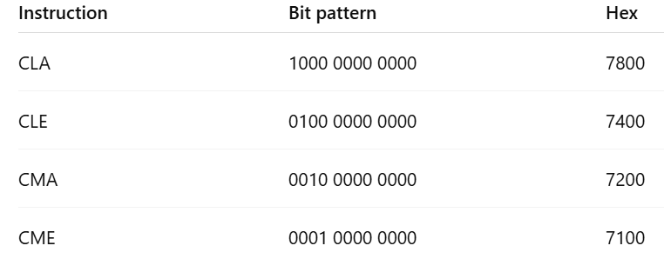
Basic Computer Instructions
Hex Code
Symbol I = 0 I = 1 Description
AND 0xxx 8xxx AND memory word to AC
ADD 1xxx 9xxx Add memory word to AC
LDA 2xxx Axxx Load AC from memory
STA 3xxx Bxxx Store content of AC into memory
BUN 4xxx Cxxx Branch unconditionally
BSA 5xxx Dxxx Branch and save return address
ISZ 6xxx Exxx Increment and skip if zero
CLA 7800 Clear AC
CLE 7400 Clear E
CMA 7200 Complement AC
CME 7100 Complement E
CIR 7080 Circulate right AC and E
CIL 7040 Circulate left AC and E
INC 7020 Increment AC
SPA 7010 Skip next instr. if AC is positive
SNA 7008 Skip next instr. if AC is negative
SZA 7004 Skip next instr. if AC is zero
SZE 7002 Skip next instr. if E is zero
HLT 7001 Halt computer
INP F800 Input character to AC
OUT F400 Output character from AC
SKI F200 Skip on input flag
SKO F100 Skip on output flag
ION F080 Interrupt on
IOF F040 Interrupt off
CSE 211, Computer Organization and Architecture

Slide 27
1. 0 010 000000101010
I = 0 → Direct addressing
Opcode = 010 → LDA
Address = 42
Meaning:
“Load the contents of memory location 42 directly into AC.”
2. 0 111 000000000001
I = 0
Opcode = 111
Last bit = 1 → HLT
Meaning:
“Stop the computer.”
0–6 / 8–E → Memory reference
7xxx → Register reference
Fxxx → I/O instruction
Instruction = A025
First hex digit = A → Indirect memory instruction
A=1010₂ → I=1, Opcode = 010 → LDA
Address = 025
Operation:
“Load AC from memory location pointed by address 025.”
3. 1 111 000000000010
I = 1
Opcode = 111
Operation = OUT
Meaning:
“Send the contents of AC to output device.”

Slide 28
Instruction Set Completeness
A computer should have a set of instructions so that the user can construct machine language programs to evaluate any function that is known to be computable.
Instruction Types
Functional Instructions operate on data (process the data)
- Arithmetic, logic, and shift instructions
- ADD, CMA, INC, CIR, CIL, AND, CLA. “Think of AC as a calculator display. These instructions change the value shown on the display.”
Transfer Instructions (move the data)
- Data transfers between the main memory and the processor registers
- LDA, STA
Control Instructions change the sequence of execution.”
- Program sequencing and control
- BUN, BSA, ISZ
Input/output Instructions allow the computer to communicate with the outside world.”
- Input and output
- INP, OUT
CSE 211, Computer Organization and Architecture

Slide 29
Control Unit
Control unit (CU) of a processor translates from machine instructions to the control signals for the microoperations that implement them
Control units are implemented in one of two ways
Hardwired Control
CU is made up of sequential and combinational circuits to generate the control signals
Microprogrammed Control
A control memory on the processor contains microprograms that activate the necessary control signals
We will consider a hardwired implementation of the control unit for the Basic Computer
CSE 211, Computer Organization and Architecture

Slide 30
Timing and Control
Control unit of Basic Computer
Goal of the CU: Generate the right control signals at the right clock time
Instruction register (IR)
Inputs:
Decoder outputs (D0–D7)
Timing signals (T0–Tn)
Control bits (I, flags)
These are combined using logic gates to generate control signals.
D0 → AND
D1 → ADD
D2 → LDA
D7 → Register / I/O instructions
“Instruction Decoder converts instruction code into one-hot signals.”
15
14 13 12
11 - 0
Other inputs
3 x 8
decoder
7 6 5 4 3 2 1 0
D
0
Combinational
Control
logic
I
D
Control
signals
7
T
15
T
0
Each T signal corresponds to one clock cycle.
T0 → Start fetch
T1 → Read memory
T2 → Decode instruction
T3 onwards → Execute
Only one T signal is active at a time
“Timing signals are like the bell periods in school.”
15 14 . . . . 2 1 0
4 x 16
decoder
4-bit
Increment (INR)
sequence
Clear (CLR)
counter
Clock
(SC)
CSE 211, Computer Organization and Architecture

Slide 31
Timing Signals
- Generated by 4-bit sequence counter and 4×16 decoder
- The SC can be incremented or cleared.
- Example: T₀, T₁, T₂, T₃, T₄, T₀, T₁, . . .
Assume: At time T₄, SC is cleared to 0 if decoder output D3 is active.
D₃T₄: SC ← 0
From waveform:
When T4 AND D3 are HIGH
CLR SC becomes HIGH
SC is cleared to 0000
Next clock → T0
Increment SC → move to next timing step
Clear SC → go back to T0 (start next instruction)
Clearing SC means instruction is finished; CPU is ready for the next instruction.”
Hence in the example instruction cycle finishes from T0 to T4.
CSE 211, Computer Organization and Architecture

Slide 32
Instruction Cycle
In Basic Computer, a machine instruction is executed in the following cycle:
Fetch an instruction from memory
Decode the instruction
Read the effective address from memory if the instruction has an indirect address
Execute the instruction (depends on the type of instruction)
After an instruction is executed, the cycle starts again at step 1, for the next instruction
Note: Every different processor has its own (different) instruction cycle
CSE 211, Computer Organization and Architecture

Slide 33
Fetch and Decode
Fetch and Decode
T0: AR ←PC (S₀S₁S₂=010, T0=1)
T1: IR ← M [AR], PC ← PC + 1 (S0S1S2=111, T1=1)
T2: D0, . . . , D7 ← Decode IR(12-14), AR ← IR(0-11), I ← IR(15)
Common bus
Timing signals (T0, T1, T2)
Control signals (S2 S1 S0, LD, INR, Read)
T1
S₂
T0
S₁
Bus
S₀
Memory
7
unit
Address
Read
AR
1
At T2, CPU understands what instruction it is, where the operand is, and whether the address is direct or indirect.
T0 and T1 (Fetch)
T2 (Decode)
Fetch and decode remains same for all instructions
LD
PC
2
INR
IR
5
LD
Clock
Common bus
CSE 211, Computer Organization and Architecture

Slide 34
Flow Chart (Instruction Cycle)
Start
SC <-- 0
Every instruction starts with SC reset to zero
Opcode is between 000 and 110 (Memory Reference)
D7 is one of output of (3*8) decoder
T0,TI (Fetch)
T2 (Decode)
T3,T4 (execute)
AR
<--
PC
T0
T1
IR
<--
M[AR],
PC
<--
PC + 1
T2
Decode Opcode in IR(12-14),
AR
<--
IR(0-11),
<--
I
IR(15)
(Register or I/O) = 1
D7
= 0 (Memory-reference)
(I/O) = 1
= 0 (register)
(indirect) = 1
= 0 (direct)
I
I
T3
T3
T3
T3
Execute
Execute
AR
<--
Nothing
M[AR]
input-output
register-reference
instruction
instruction
SC
<--
0
SC
<--
0
Execute
T4
memory-reference
instruction
SC
<--
0
CSE 211, Computer Organization and Architecture

Slide 35
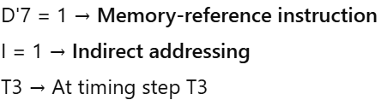
Determining Type of Instruction
D'7IT3: AR ← M[AR]
D'7I'T3: Nothing (As AR already contains the effective address)
D7I'T3: Execute a register-reference instr.
D7IT3: Execute an input-output instr.
Opcode type | I bit | Action at T3
Memory-ref | I = 1 | AR ← M[AR]
Memory-ref | I = 0 | Nothing
Reg-ref | I = 0 | Execute reg-ref
I/O | I = 1 | Execute I/O
CSE 211, Computer Organization and Architecture

Slide 36
Basic Computer Instructions
Hex Code
Symbol I = 0 I = 1 Description
AND 0xxx 8xxx AND memory word to AC
ADD 1xxx 9xxx Add memory word to AC
LDA 2xxx Axxx Load AC from memory
STA 3xxx Bxxx Store content of AC into memory
BUN 4xxx Cxxx Branch unconditionally
BSA 5xxx Dxxx Branch and save return address
ISZ 6xxx Exxx Increment and skip if zero
CLA 7800 Clear AC
CLE 7400 Clear E
CMA 7200 Complement AC
CME 7100 Complement E
CIR 7080 Circulate right AC and E
CIL 7040 Circulate left AC and E
INC 7020 Increment AC
SPA 7010 Skip next instr. if AC is positive
SNA 7008 Skip next instr. if AC is negative
SZA 7004 Skip next instr. if AC is zero
SZE 7002 Skip next instr. if E is zero
HLT 7001 Halt computer
INP F800 Input character to AC
OUT F400 Output character from AC
SKI F200 Skip on input flag
SKO F100 Skip on output flag
ION F080 Interrupt on
IOF F040 Interrupt off
CSE 211, Computer Organization and Architecture

Slide 37
Register Reference Instruction
Register Reference Instructions are identified when (No address, no memory, executes in T3)
Each bit Bi corresponds to one register reference instruction
Only one bit is set to 1 at a time
- D₇ = 1, I = 0, Opcode = 111
- Register Ref. Instr. is specified in b₀ ~ b₁₁ of IR
- Execution directly starts with timing signal T₃
r = D₇ I′T₃ => Register Reference Instruction (r=1)
B_{i} = IR(i) , i=0,1,2,...,11
r: SC ← 0
CLA rB₁₁: AC ← 0 (clear accumulator)
CLE rB₁₀: E ← 0
CMA rB₉: AC ← AC’ (1’s complement accumulator)
CME rB₈: E ← E’
CIR rB₇: AC ← shr AC, AC(15) ← E, E ← AC(0)
CIL rB₆: AC ← shl AC, AC(0) ← E, E ← AC(15)
INC rB₅: AC ← AC + 1
SPA rB₄: if (AC(15) = 0) then (PC ← PC+1) (AC positive)
SNA rB₃: if (AC(15) = 1) then (PC ← PC+1)
SZA rB₂: if (AC = 0) then (PC ← PC+1)
SZE rB₁: if (E = 0) then (PC ← PC+1)
HLT rB₀: S ← 0 (S is a start-stop flip-flop)(Execution stops/hault)
CSE 211, Computer Organization and Architecture

Slide 38
Memory Reference Instructions
Symbol
Operation
Decoder
Symbolic Description
AND D₀ AC ← AC ∧ M[AR] (Logical and with operand fetch from memory
ADD D₁ AC ← AC + M[AR], E ← C_{out}
LDA D₂ AC ← M[AR]
STA D₃ M[AR] ← AC (Stores accumulator contents into memory)
BUN D₄ PC ← AR (Changes program flow)
BSA D₅ M[AR] ← PC, PC ← AR + 1
ISZ D₆ M[AR] ← M[AR] + 1, if M[AR] + 1 = 0 then PC ← PC+1
- The effective address of the instruction is in AR and was placed there during
timing signal T₂ when I = 0, or during timing signal T₃ when I = 1
- Memory cycle is assumed to be short enough to complete in a CPU cycle
- The execution of MR instruction starts with T₄
AND to AC
D₀T₄: DR ← M[AR] Read operand
D₀T₅: AC ← AC ∧ DR, SC ← 0 AND with AC
ADD to AC
D₁T₄: DR ← M[AR] Read/Fetch operand
D₁T₅: AC ← AC + DR, E ← C_{out}, SC ← 0 Add to AC and store carry in E, Reset SC
CSE 211, Computer Organization and Architecture

Slide 39
Memory Reference Instructions
LDA: Load to AC
D₂T₄: DR ← M[AR] (Read memory)
D₂T₅: AC ← DR, SC ← 0
STA: Store AC
D₃T₄: M[AR] ← AC, SC ← 0 (Write operation)
BUN: Branch Unconditionally
D₄T₄: PC ← AR, SC ← 0 (program control jumps to AR)
BSA: Branch and Save Return Address
M[AR] ← PC, PC ← AR + 1 (Used for subroutine calls)
M[135] ← 21 Return address stored in memory
PC ← AR + 1 = 136, Control jumps to subroutine
Execution continues inside the subroutine.
Address 135 contains the return address (21)
BUN 135 → PC ← M[135]
Control returns to next instruction
Memory, PC, AR at time T4
Memory, PC after execution
20
0
BSA
135
20
0
BSA
135
PC = 21
Next instruction
21
Next instruction
AR = 135
135
21
136
Subroutine
PC = 136
Subroutine
1
BUN
135
1
BUN
135
CSE 211, Computer Organization and Architecture

Slide 40
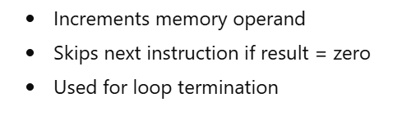
Memory Reference Instructions
BSA:
D₅T₄: M[AR] ← PC, AR ← AR + 1 (Store return address → jump to subroutine)
D₅T₅: PC ← AR, SC ← 0
ISZ: Increment and Skip-if-Zero (Used in loop control)
D₆T₄: DR ← M[AR]
D₆T₅: DR ← DR + 1
D₆T₄: M[AR] ← DR, if (DR = 0) then (PC ← PC + 1), SC ← 0
CSE 211, Computer Organization and Architecture

Slide 41
Flow Chart - Memory Reference Instructions
Memory-reference instruction
AND
ADD
LDA
STA
D T
D T
D T
D T
0
4
1
4
2
4
3
4
DR ← M[AR]
DR ← M[AR]
DR ← M[AR]
M[AR] ← AC
SC ← 0
All memory-reference instructions share the same beginning:
T0–T3 → Instruction Fetch + Decode + Effective Address calculation
At T4 onward, execution depends on opcode → D0 to D6
E stores carry → used for overflow detection
STA is faster because it avoids extra register movement
The number of T-states depends on how many internal operations an instruction needs, not on its opcode length.
D T
D T
D T
0
5
1
5
2
5
AC ← AC ∧ DR
AC ← AC + DR
AC ← DR
SC ← 0
E ← Cout
SC ← 0
SC ← 0
BUN
BSA
ISZ
D T
D T
D T
4
4
5
4
6
4
PC ← AR
M[AR] ← PC
DR ← M[AR]
SC ← 0
AR ← AR + 1
D T
D T
5
5
6
5
PC ← AR
DR ← DR + 1
SC ← 0
D T
6
6
M[AR] ← DR
If (DR = 0)
then (PC ← PC + 1)
SC ← 0
CSE 211, Computer Organization and Architecture

Slide 42
Input/Output and Interrupt
A Terminal with a keyboard and a Printer
Devices like keyboard/printer work serially 2. CPU works in parallel, we need interfaces to convert between them
Transmitter converts serial data → parallel data
Acts as a buffer + converter
Usually, lower 8 bits of AC are used
Receiver Converts parallel data → serial
Sends data to printer serially
IEN controls whether CPU responds to I/O interrupts
Input-Output Configuration
Input-output
Serial
Computer
registers and
flip-flops
terminal
communication
interface
Printer
Receiver
OUTR
FGO
interface
AC
Keyboard
Transmitter
INPR
FGI
INPR Input register - 8 bits
OUTR Output register - 8 bits
FGI Input flag - 1 bit
FGO Output flag - 1 bit
IEN Interrupt enable - 1 bit
interface
Serial Communications Path
Parallel Communications Path
CSE 211, Computer Organization and Architecture

Slide 43
Input/Output and Interrupt
A Terminal with a keyboard and a Printer (Program-controlled I/O (polling)
Transmisson Process -
- The terminal sends and receives serial information
- The serial info. from the keyboard is shifted into INPR
- The serial info. for the printer is stored in the OUTR
- INPR and OUTR communicate with the terminal serially and with the AC in parallel.
The flags are needed to synchronize the timing difference between I/O device and the computer
Why synchronization is needed?
CPU speed → GHz
Keyboard/printer → very slow
1. FGI (Input Flag)
FGI = 1 → New input available
FGI = 0 → No input
2. FGO (Output Flag)
FGO = 1 → Printer ready
FGO = 0 → Printer busy
CSE 211, Computer Organization and Architecture

Slide 44
Input/Output Instructions
All I/O instructions execute at T3 only
No memory access, no T4, T5…
D₇IT₃ = p (Control function enabling I/O operations)
IR(i) = B_{i}, i = 6 to 11 (These bits select which I/O instruction to execute)
p: SC ← 0 Clear SC
INP pB₁₁: AC(0-7) ← INPR, FGI ← 0 Input character. to AC
OUT pB₁₀: OUTR ← AC(0-7), FGO ← 0 Output char. from AC
SKI pB₉: if(FGI = 1) then (PC ← PC + 1) Skip if input flag=1
SKO pB₈: if(FGO = 1) then (PC ← PC + 1) Skip if output flag=1
ION pB₇: IEN ← 1 Interrupt enable on
IOF pB₆: IEN ← 0 Interrupt enable off
SKI, If input is ready, skip next instruction
SKO, Skip next instruction if printer is ready
ION, CPU can respond when FGI or FGO becomes 1(Enable Interrupts)
IOF, CPU ignores device requests (Disable Interrupts)
SKI and SKO used in program-controlled I/O and affect Program Flow
CSE 211, Computer Organization and Architecture

Slide 45
Interrupt Initiated Input/Output
1. Open communication only when some data has to be passed --> interrupt.
CPU does NOT continuously check the device, No waste of CPU time
2. The I/O interface, instead of the CPU, monitors the I/O device.
Interface hardware watches:
Keyboard status
Printer status
CPU is free
Monitoring responsibility is offloaded from CPU to interface
3. When the interface founds that the I/O device is ready for data transfer,
it generates an interrupt request to the CPU
4. In interrupt-driven I/O, the I/O interface monitors the device and generates an interrupt request to the CPU only when data transfer is required, eliminating continuous polling by the processor.
CSE 211, Computer Organization and Architecture

Slide 46
Interrupt Initiated Input/Output
- Upon detecting an interrupt, the CPU stops momentarily the task
it is doing, branches to the service routine to process the data
transfer, and then returns to the task it was performing.
1. CPU finishes the current instruction 2. Detects interrupt request (R = 1) 3. Branches to Interrupt Service Routine (ISR) 4. Performs I/O data transfer 5. Returns to the interrupted program
FGI – 1 new info. Is available to input device……0 info accepted by computer
FGO – 1 info tranffered from AC to OUTR (device ready) ………0 don’t load new data (device busy)
IEN (Interrupt-enable flip-flop)
- can be set and cleared by instructions like ION and IOF
when cleared, the computer cannot be interrupted (IEN = 0), CPU continues normal execution
Think of IEN as an ON/OFF switch for interrupts.
IEN enables or disables interrupt requests; when it is cleared, the CPU ignores all I/O interrupts regardless of device status.
CSE 211, Computer Organization and Architecture

Slide 47
Flow Chart of Interrupt Cycle
R = Interrupt f/f
INPR Input register - 8 bits
OUTR Output register - 8 bits
FGI Input flag - 1 bit
FGO Output flag - 1 bit
IEN Interrupt enable - 1 bit
=0
Instruction cycle
R
=1
Interrupt cycle
Fetch and decode
Store return address
instructions
in location 0
IEN = 1 AND (FGI = 1 OR FGO = 1), R ← 1
Now the CPU enters the interrupt cycle
The interrupt cycle takes three clock cycles
Next instruction fetched will be from memory location 1
M[1] = BUN ISR
BUN 0 I (Indirect addressing loads PC ← M[0], Main program resumes correctly
M[0] ← PC
Execute
IEN
=0
instructions
=1
Branch to location 1
=1
PC ← 1
FGI
=0
=1
FGO
IEN ← 0
R ← 0
=0
R ← 1
- The interrupt cycle is a HW implementation of a branch and save return address operation.
- At the beginning of the next instruction cycle, the instruction that is read from memory is in address 1.
- At memory address 1, the programmer must store a branch instruction that sends the control to an interrupt service routine
- The instruction that returns the control to the original program is "indirect BUN 0"
CSE 211, Computer Organization and Architecture

Slide 48
Register Transfer Operations in Interrupt Cycle
Memory
Before interrupt
After interrupt cycle
0
0
256
1
0
BUN
1120
PC = 1
0
BUN
1120
255
Main
Main
PC = 256
Program
255
Program
256
1120
1120
I/O
I/O
Program
Program
1
BUN
0
1
BUN
0
Register Transfer Statements for Interrupt Cycle
R =1 if IEN (FGI + FGO)T₀′T₁′T₂′ (current execution finished)
⇔ T₀′T₁′T₂′ (IEN)(FGI + FGO): R ← 1 (set interrupt flip flop)
- The fetch and decode phases of the instruction cycle
must be modified ➔Replace T₀, T₁, T₂ with R'T₀, R'T₁, R’T₂
- The interrupt cycle :
RT₀: AR ← 0, TR ← PC
RT₁: M[AR] ← TR, PC ← 0
RT₂: PC ← PC + 1, IEN ← 0, R ← 0, SC ← 0 (256 return address, PC becomes 1, Interrupt cycle ends, Control returns to fetch cycle, CPU jumps to I/O program at 1120, Main program resumes exactly where it stopped.
CSE 211, Computer Organization and Architecture

Slide 49
Complete Computer Design
start
SC ← 0, IEN ← 0, R ← 0
INPR Input register - 8 bits
OUTR Output register - 8 bits
FGI Input flag - 1 bit
FGO Output flag - 1 bit
IEN Interrupt enable - 1 bit
=0(Instruction =1(Interrupt
Cycle) Cycle)
R
R’T₀
RT₀
AR ← PC
R’T₁
AR ← 0, TR ← PC
RT₁
R = Interrupt flip-flop
Interrupt is recognized only after completing the current instruction
Return address safely held in TR
Memory address prepared
Contents of PC are stored in M[0]
PC is cleared
PC becomes 1, Disable further interrupts , Next instruction fetched will be from memory address 1
Memory 0 has old/return address
Memory address 1 has interrupt routine.
IR ← M[AR], PC ← PC + 1
M[AR] ← TR, PC ← 0
R’T₂
RT₂
AR ← IR(0~11), I ← IR(15)
D₀...D₇ ← Decode IR(12 ~ 14)
PC ← PC + 1, IEN ← 0
R ← 0, SC ← 0
=1(Register or I/O) =0(Memory Ref)
D₇
=1 (I/O) =0 (Register) =1(Indir) =0(Dir)
I
I
D₇IT₃ D₇I’T₃
D₇’IT3 D₇’I’T3
Execute
I/O
Instruction
Execute
RR
Instruction
AR <- M[AR]
Idle
Execute MR
Instruction
D₇’T4
CSE 211, Computer Organization and Architecture

Slide 50
Complete Computer Design
Fetch
Decode
Indirect
Interrupt
Memory-Reference
AND
ADD
LDA
STA
BUN
BSA
ISZ
R′T₀:
R′T₁:
R′T₂:
D₇′IT₃:
RT₀:
RT₁:
RT₂:
D₀T₄:
D₀T₅:
D₁T₄:
D₁T₅:
D₂T₄:
D₂T₅:
D₃T₄:
D₄T₄:
D₅T₄:
D₅T₅:
D₆T₄:
D₆T₅:
D₆T₆:
AR ← PC (No interrupt)
IR ← M[AR], PC ← PC + 1
D0, ..., D7 ← Decode IR(12 ~ 14),
AR ← IR(0 ~ 11), I ← IR(15)
AR ← M[AR]
R ← 1 (Interrupt cycle)
AR ← 0, TR ← PC
M[AR] ← TR, PC ← 0
PC ← PC + 1, IEN ← 0, R ← 0, SC ← 0
DR ← M[AR]
AC ← AC ∧ DR, SC ← 0
DR ← M[AR]
AC ← AC + DR, E ← C_{out}, SC ← 0
DR ← M[AR]
AC ← DR, SC ← 0
M[AR] ← AC, SC ← 0
PC ← AR, SC ← 0
M[AR] ← PC, AR ← AR + 1
PC ← AR, SC ← 0
DR ← M[AR]
DR ← DR + 1
M[AR] ← DR, if(DR=0) then (PC ← PC + 1),
SC ← 0
CSE 211, Computer Organization and Architecture

Slide 51
Complete Computer Design
Register-Reference
CLA
CLE
CMA
CME
CIR
CIL
INC
SPA
SNA
SZA
SZE
HLT
Input-Output
INP
OUT
SKI
SKO
ION
IOF
D₇I′T₃ = r
IR(i) = B_{i}
r:
rB₁₁:
rB₁₀:
rB₉:
rB₈:
rB₇:
rB₆:
rB₅:
rB₄:
rB₃:
rB₂:
rB₁:
rB₀:
D₇IT₃ = p
IR(i) = B_{i}
p:
pB₁₁:
pB₁₀:
pB₉:
pB₈:
pB₇:
pB₆:
(Common to all register-reference instr)
(i = 0,1,2, ..., 11)
SC ← 0
AC ← 0
E ← 0
AC ← AC′
E ← E′
AC ← shr AC, AC(15) ← E, E ← AC(0)
AC ← shl AC, AC(0) ← E, E ← AC(15)
AC ← AC + 1
If(AC(15) =0) then (PC ← PC + 1)
If(AC(15) =1) then (PC ← PC + 1)
If(AC = 0) then (PC ← PC + 1)
If(E=0) then (PC ← PC + 1)
S ← 0
(Common to all input-output instructions)
(i = 6,7,8,9,10,11)
SC ← 0
AC(0-7) ← INPR, FGI ← 0
OUTR ← AC(0-7), FGO ← 0
If(FGI=1) then (PC ← PC + 1)
If(FGO=1) then (PC ← PC + 1)
IEN ← 1
IEN ← 0
CSE 211, Computer Organization and Architecture

Slide 52
Design of a Basic Computer
Hardware Components of Basic computer
A memory unit: 4096 x 16.
Registers:
AR, PC, DR, AC, IR, TR, OUTR, INPR, and SC (Generates T₀, T₁, T₂…)
Flip-Flops(Status): (1 bit memory elements)
I, S, E, R, IEN, FGI, and FGO
Decoders: a 3x8 Opcode decoder (Decodes IR(12–14), Generates D₀ to D₇)
a 4x16 timing decoder (Driven by SC, Generates T₀ to T₁₅ )
Common bus: 16 bits
Control logic gates:
Adder and Logic circuit: Connected to AC
Control Logic Gates
- Input Controls of the nine registers
- Read and Write Controls of memory
- Set, Clear, or Complement Controls of the flip-flops
- S₂, S₁, S₀ Controls to select a register for the bus
- AC, and Adder and Logic circuit
CSE 211, Computer Organization and Architecture

